Slide 1

Unit-7 Java Web Frameworks Spring MVC
Advance java Programming (AJP)
GTU # 3160707
Prof. Rajkumar B. Gondaliya
Computer Engineering Department
rajkumar.gondaliya@darshan.ac.in
+918141999120, +919723232741

Slide 2

Looping
Outline
Overview of MVC
Advantage of MVC Framework
Overview of Spring
Spring Architecture
Advantage of Spring MVC Framework
XML Configuration on Spring
Steps to run simple Spring application program
Bean life cycle
Aspect – oriented Spring
Managing Database
Managing Transaction

Slide 3
MVC – An overview
MVC stands for Model View and Controller.
It is a design pattern that separates the business logic, presentation logic and data.
Controller acts as an interface between View and Model. Controller intercepts all the incoming requests.
Model represents the state of the application i.e. data. It can also have business logic.
View represents the presentation i.e. UI(User Interface).
In JavaEE application,
Servlet as a controller
JSP as a view component
Java Bean class as a model

Slide 4

MVC – An overview
Container
Controller
(Filter/Servlet)
Database
Client
View
(JSP)
Model
(Java Bean)

Slide 5
Advantage of MVC Framework
Faster Development Process
MVC supports rapid and parallel development.
If an MVC model is used to develop any particular web application then it is possible that one programmer can work on the view
While the other can work on the controller to create the business logic of the web application.
Ability To Provide Multiple Views
In the MVC Model, you can create multiple views for a model.
Today, there is an increasing demand for new ways to access your application and for that MVC development is certainly a great solution.
Moreover, in this method, Code duplication is very limited because it separates data and business logic from the display.

Slide 6
Advantage of MVC Framework
Support For Asynchronous Technique
The MVC architecture can also integrate with the JavaScript Framework.
This means that MVC applications can be made to work even with PDF files, site-specific browsers, and also with desktop widgets.
MVC also supports an asynchronous technique, which helps developers to develop an application that loads very fast.
The Modification Does Not Affect The Entire Model
the user interface tends to change more frequently than even the business rules of the .net development company.
It is obvious that you make frequent changes in your web application like changing colors, fonts, screen layouts, and adding new device support for mobile phones or tablets.
Moreover, Adding a new type of view are very easy in the MVC pattern because the Model part does not depend on the views part.
Therefore, any changes in the Model will not affect the entire architecture.

Slide 7
Advantage of MVC Framework
MVC Model Returns The Data Without Formatting
MVC pattern returns data without applying any formatting.
Hence, the same components can be used and called for use with any interface.
For example, any kind of data can be formatted with HTML, but it could also be formatted with Macromedia Flash or Dream viewer.
SEO Friendly Development Platform
MVC platform supports the development of SEO friendly web pages or web applications.
Using this platform, it is very easy to develop SEO-friendly URLs to generate more visits from a specific application.
This development architecture is commonly used in Test-Driven Development applications.
Moreover, Scripting languages like JavaScript and jQuery can be integrated with MVC to develop feature-rich web applications.

Slide 8
Overview of Spring
What is Spring?
Spring is a dependency injection framework to make java application loosely coupled.
Spring framework makes the easy development of JavaEE application.
Dependency Injection
Dependency Injection (DI) is a design pattern used to implement IoC.
It allows the creation of dependent objects outside of a class and provides those objects to a class through different ways.
Using DI, we move the creation and binding of the dependent objects outside of the class that depends on them.

Slide 9
Overview of Spring
The Dependency Injection pattern involves 3 types of classes.
Client Class: The client class (dependent class) is a class which depends on the service class
Service Class: The service class (dependency) is a class that provides service to the client class.
Injector Class: The injector class injects the service class object into the client class.
Client
Uses
Service
Injects
Injector

Slide 10
Overview of Spring
public class ClientA {
ServiceB service;
public void doSomething() {
String info = service.getInfo();
}
}
public class ServiceB {
public String getInfo() {
return “ServiceB’s Info”;
}
}
This process is called Inversion of Control (IOC).
As the name suggests, it is used to invert different kinds of controls in object-oriented design to achieve loose coupling.
Using metadata we can implement Inversion of Control.
Use annotation or XML for Metadata.

Slide 11
Spring Architecture
There are around 20 modules in Spring Architecture
These modules are grouped into
Core Container
Data Access-Integration
Aspect Oriented Programming(AOP)
Instrumentation
Test

Slide 12
Spring Architecture/Framework/Modules
Data
Access/integration
JDBC
ORM
Web
Servlet
OXM
JMS
Portlet
WebSocket
Web
Transaction
Struts
AOP
Aspect
Instrumentation
Messaging
Core
Container
Core
Beans
Context
Expression
Language
Test

Slide 13
Spring Architecture
Core Container
Core Module
This is fundamental part of spring framework.
This module consists of IoC and Dependency Injection features.
Bean Module
This module provides BeanFactory class.
Which is a sophisticated implementation of the factory pattern.
Context Module
This module is based on Core and Bean modules.
it is a medium to access any objects defined and configured.
The ApplicationContext interface is an important point in this module.
Expression Language Module
The SpEL module provides a powerful expression language for querying and manipulating an object graph at runtime.

Slide 14
Spring Architecture
Data Access/integration
JDBC
When we use core JDBC programming then we have to write lot of code.
The JDBC module of Spring framework removes this complexity by providing JDBC abstraction layer.
ORM
This module provides integration layers for popular object-relational mapping APIs, including JPA, JDO, Hibernate, and iBatis.
It provides code without worrying about catching exceptions specific to each persistence technology.
OXM
It is used to converts object into XML format and vice versa.
Provide uniform API to access any of the OXM frameworks such as Castor, XMLBeans, etc.

Slide 15
Spring Architecture
Data Access/integration
JMS
The Java Messaging Service JMS module contains features for producing and consuming messages.
Transaction
This module supports programmatic and declarative transaction management for classes that implement special interfaces and for all your POJOs.

Slide 16
Spring Architecture
Web
Web
This module provides basic web-oriented integration features such as multipart file-upload functionality.
Also provide initialization of the IoC container using servlet listeners and a web-oriented application context.
Web-Servlet
This module contains the model view container based implementation for web application.
Web-Struts
This module provides the support for the integration of classic struts web tire within the spring application.
Web-Portlet
The Web-Portlet module provides the MVC implementation to be used in a portlet environment and mirrors the functionality of Web-Servlet module.

Slide 17
Spring Architecture
AOP
This module provides an aspect-oriented programming implementation.
It’s allowing you to define method-interceptors and pointcuts to cleanly decouple code that implements functionality that should be separated.
So you can introduce new functionalities into existing code without modifying it.
Aspects
This module provides integration with AspectJ.
Which is again a powerful and mature AOP framework.
Instrumentation
This module provides class instrumentation support and class loader implementations to be used in certain application servers.

Slide 18
Spring Architecture
Messaging
This module provides support for STOMP(Simple\Streaming Text Oriented Message Protocol) as the WebSocket sub-protocol to use in applications.
It also supports an annotation programming model for routing and processing STOMP messages from WebSocket clients.
Test
The Test module supports the testing of Spring components with JUnit or TestNG frameworks.

Slide 19
Advantage of Spring MVC Framework
Predefined Templates
Loose Coupling
Easy to test
Lightweight
Fast Development
Declarative Support
Hibernate and JDBC Support
MVC Architecture and JavaBean Support

Slide 20
IoC Containers
The IoC(Inversion of Control) container is at the core of the Spring Framework.
The task of IoC container is to manage the java objects from instantiation to destruction.
These object are basically called as Spring Beans.
The container gets its instructions about which are those objects to instantiate, configure and assemble by reading configuration metadata provided.
The configuration metadata can be represented either by XML, Java annotation, or java code.
The application POJO classes and configuration metadata are combined to have a fully configured and executable system of application ready for work
Java POJO
Spring
Container
Ready to use application
Metadata

Slide 21
Type of IoC Containers
BeanFactory Container
This is the simplest container providing the basic support for DI and is defined by the org.springframework.beans.factory.BeanFactory interface.
For using the BeanFactory we need to get the instance of XMLBeanFactory.
Resource rec=new ClassPathResource(“Beans.xml”)
XmlBeanFactory factory = new XmlBeanFactory (rec);

Slide 22
Type of IoC Containers
ApplicationContext Container
The org.springframework.context.ApplicationContext interface acts as the IoC container.
This container adds more enterprise-specific functionality such as the ability to resolve textual messages from a properties file and the ability to publish application events to interested event listeners.
The most commonly used ApplicationContext implementations are
FileSystemXmlApplicationContext
ClassPathXmlApplicationContext
AnnotationConfigApplicationContext
ApplicationContext context = new FileSystemXmlApplicationContext
(“C:/Users/workspace/HelloSpring/src/Beans.xml”);

Slide 23
XML Configuration on Spring
The configuration file is an XML file in Spring.
It binds the bean classes together.
When spring application gets loaded into memory, Framework makes use of the XMl configuration file to create all the beans defined and assign them unique ID as defined in <bean> tag.
You can use <property> tag to pass the value of different variables used at the time of object creation.

Slide 24
XML Configuration on Spring
<?xml version=“1.0” encoding=“UTF-8”?>
<beans xmlns=“http://www.springframework.org/schema/beans”
xmlns:xsi=“http://www.w3.org/2001/XMLSchema-instance”
xsi:schemaLocation=“http://www.springframework.org/schema/beans
http://www.springframework.org/schema/beans/spring-beans-3.2.xsd” >
<bean id = “studentbean” class = “springtest.StudentBean” >
<property name = “Name” value = “Raj” />
<property name = “Address” value = “Rajkot” />
</bean>
</beans>
Bean ID is given
Bean Class Name
Value Assign to Bean Property
Property of Bean

Slide 25
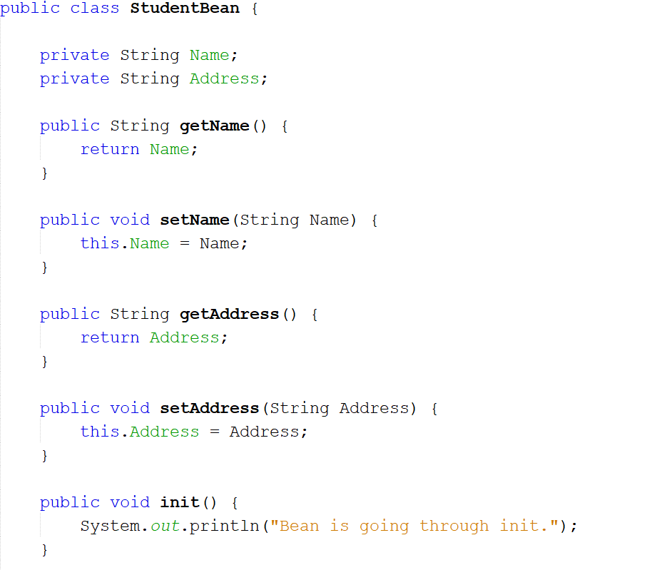
Steps to run simple Spring application program
Step 1: Create new java application
Step 2: Load Jar file of Spring in project
Step 3: Create a POJO(Plain Old Java Objects) class

Slide 26
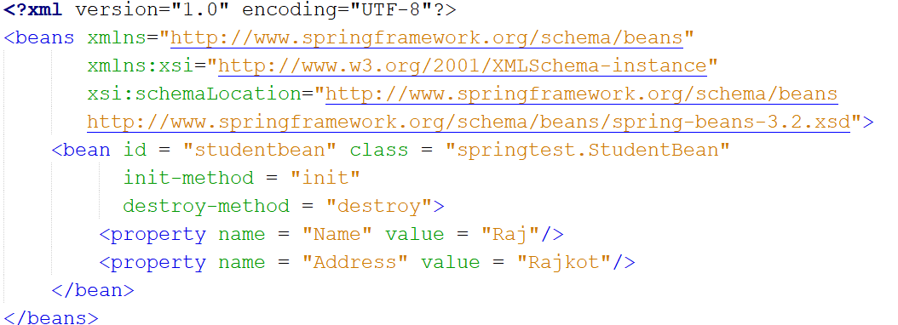
Steps to run simple Spring application program
Step 4: Creating the configuration XML for ApplicationContext.
Step 5: Creating ApplicationContext class object and Initialize it using ClassPathXmlApplicationContext
Step 6: Create associated class object
Initialize it using ApplicationContext object’s getBean() method.

Slide 27
Bean Lifecycle
During the Bean Lifecycle there are two important phases.
Instantiation
Destruction
Instantiation: in this phase perform some initialization to get it into a usable state
Destruction: when the bean is no longer required and is removed from the container, some cleanup may be required.
We declare bean using <bean> along with the init-method and destroy-method parameter in configuration file.
public class BeanProgram {
public void init(){
//do Initialize
}
public void destroy(){
//do cleanup
}
}
<bean id = “studentbean” class = “springtest.StudentBean”
init-method = “init”
destroy-method = “destroy” >
<property name = “Name” value = “XYZ” />
</bean>

Slide 28
Aspect Oriented Programming
One of the key components of Spring is the AOP framework.
Aspect-Oriented Programming (AOP) complements Object-Oriented Programming (OOP) by providing another way of thinking about program structure.
The key unit of modularity in OOP is the class, whereas in AOP the unit of modularity is the aspect.
Aspects enable the modularization of concerns such as transaction management that cut across multiple types and objects.

Slide 29
AOP terminology
Aspect
A module which has a set of APIs providing cross-cutting requirement.
Aspects are implement using regular classes.
Join point
A joint point is any point in your program such as method execution, exception handling, field access etc.
Spring support only method execution join point
Pointcut
It is an expression language of AOP that matches join points.

Slide 30
AOP terminology
Advice
Advice represent an action taken by an aspect at a particular join point. There are different type of advices.
Before advice: Advice that executes before a join point.
After returning advice: Advice to be executed after a join point completes normally.
After throwing advice: Advice to be executed if a method exits by throwing an exception.
After (finally) advice: Advice to be executed regardless of the means by which a join point exits (normal or exceptional return).
Around advice: It executes before and after a join points.

Slide 31
Managing Database
Spring JdbcTemplate is a powerful mechanism to connect to the database and execute SQL queries.
It internally uses JDBC api, but eliminates a lot of problems of JDBC API.
Problems of JDBC API
We need to write a lot of code before and after executing the query, such as creating connection, statement, closing resultset, connection etc.
We need to perform exception handling code on the database logic.
We need to handle transaction.
Repetition of all these codes from one to another database logic is a time consuming task.

Slide 32
JdbcTemplate class
JdbcTemplate class is the central class in the Spring JDBC support classes.
It takes care of creation and release of resources such as creating and closing of connection object etc.
So it will not lead to any problem if you forget to close the connection.
It handles the exception and provides the informative exception messages by the help of exception classes defined in the org.springframework.dao package.
We can perform all the database operations by the help of JdbcTemplate class such as insertion, updation, deletion and retrieval of the data from the database.

Slide 33
Methods of Spring JdbcTemplate class.
Method | Description
public int update(String query) | It is used to insert, update and delete records.
public int update(String query,Object... args) | It is used to insert, update and delete records using PreparedStatement using given arguments.
public void execute(String query) | is used to execute DDL query.

Slide 34
Managing Transaction
The transaction are set of action that are treated as a single unit of work.
Transaction management is an important activity in handling databases in order to maintain integrity and consistency.
Spring framework provides a consistent abstraction for transaction management.
A simple transaction is usually issued to the database system
Begin the transaction
Execute several queries
Commit the transaction
Spring support both programmatic and declarative transaction management.
Programmatic transaction management means manage the transaction with the help of programs.
Declarative transaction management means the XML based or annotation based configuration are used to manage the transactions.

Slide 35
Managing Transaction
Local Transactions | Global Transactions
Local transactions are specific to a single transactional resource like a JDBC connection | global transactions can span multiple transactional resources like transaction in a distributed system.
Local transaction management can be useful in a centralized computing environment. | Global transaction management is required in a distributed computing environment
Application components and resources are located at a single site | All the resources are distributed across multiple systems.
Transaction management only involves a local data manager running on a single machine. | Transaction management needs to be done both at local and global levels.

Slide 36
GTU Questions
Sr No | Question
1 | Explain MVC Architecture.
2 | What are the differences between Java Bean and basic java class? Explain Java Bean Architecture.
3 | Differentiate : Java Bean and basic java class and Explain Java Bean Architecture and Show the use of JSP inbuilt objects: request and response, with their use in application
4 | What is Spring Web MVC framework? List its key features.
5 | Explain MVC architecture in detail with figure.
6 | Write a java bean named “student” having roll no and name having getter & setter methods. Write a JSP page to set the roll number and name for a student object and then print them by reading from object.
7 | What is MVC architecture? Explain Spring architecture with neatsketch.
8 | What is Dependency Injection?
9 | Briefly explain spring bean life cycle.

Slide 37
Advance java Programming (AJP)
Prof. Rajkumar B. Gondaliya
Computer Engineering Department
rajkumar.gondaliya@darshan.ac.in
+918141999120, +919723232741

